Slide 1
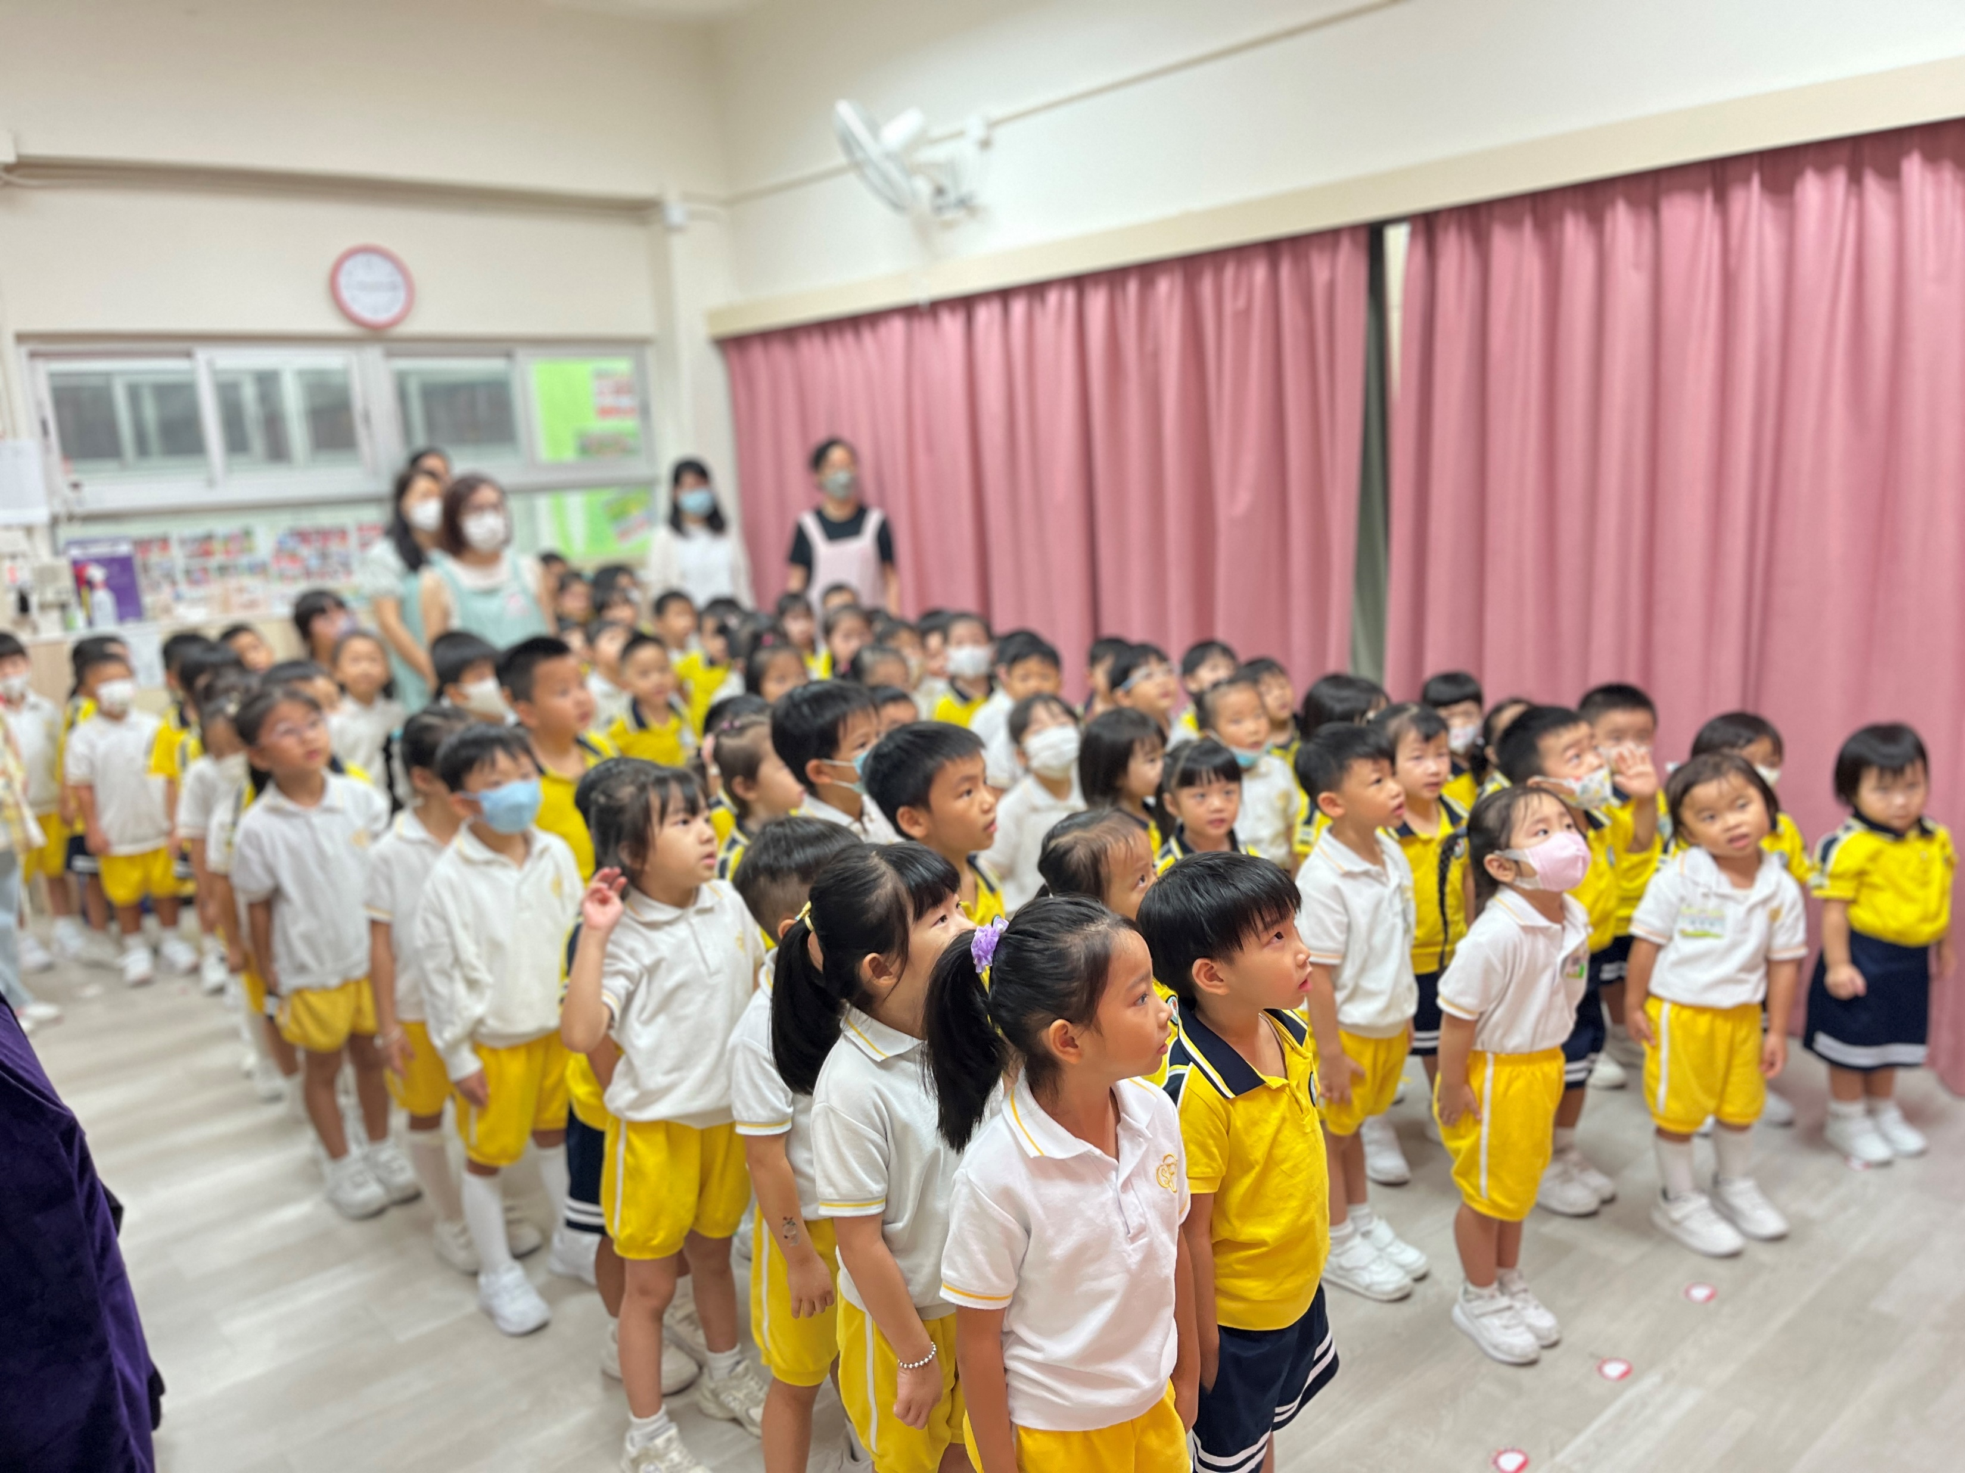
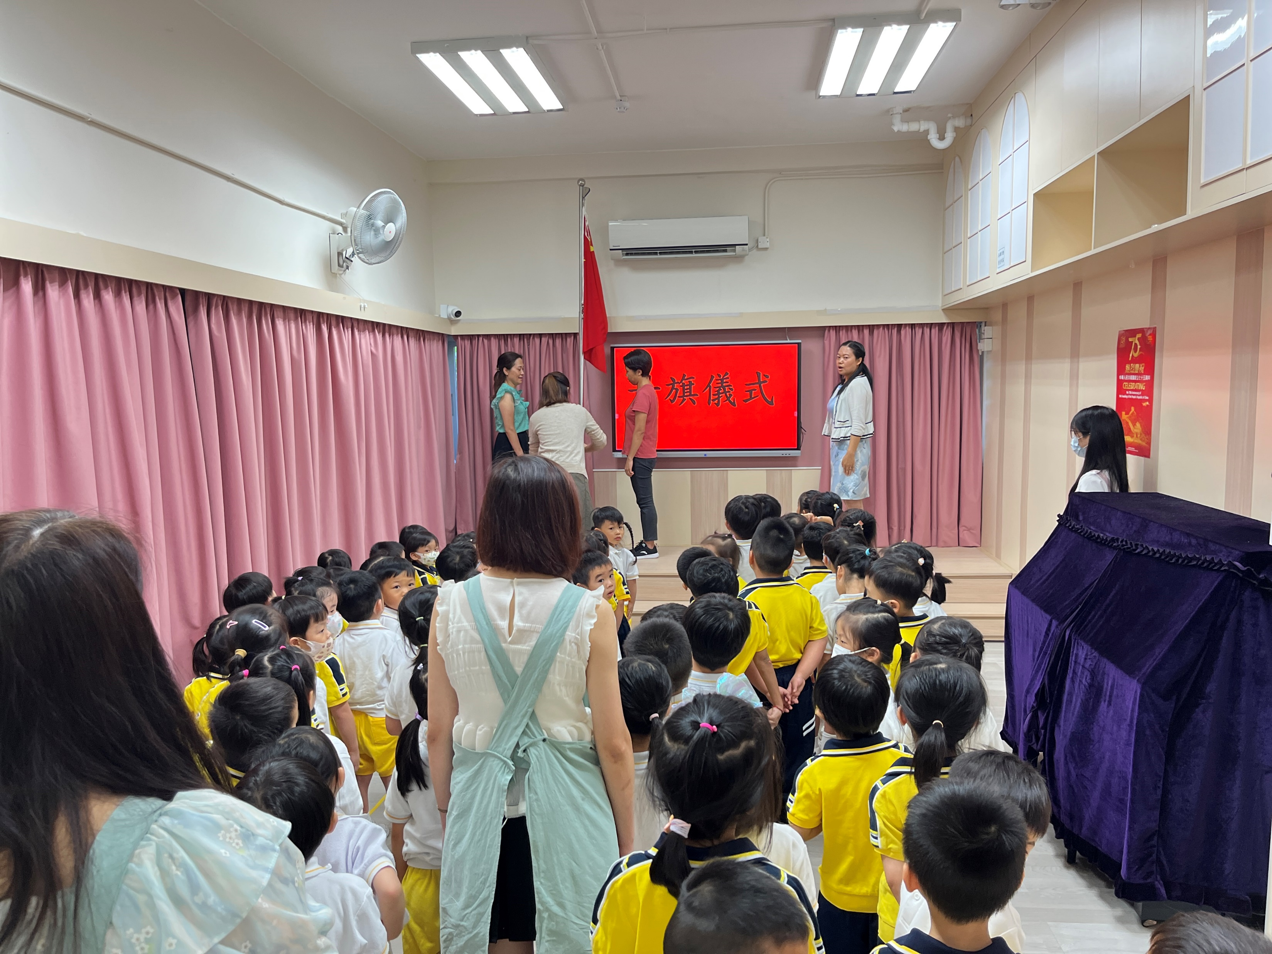
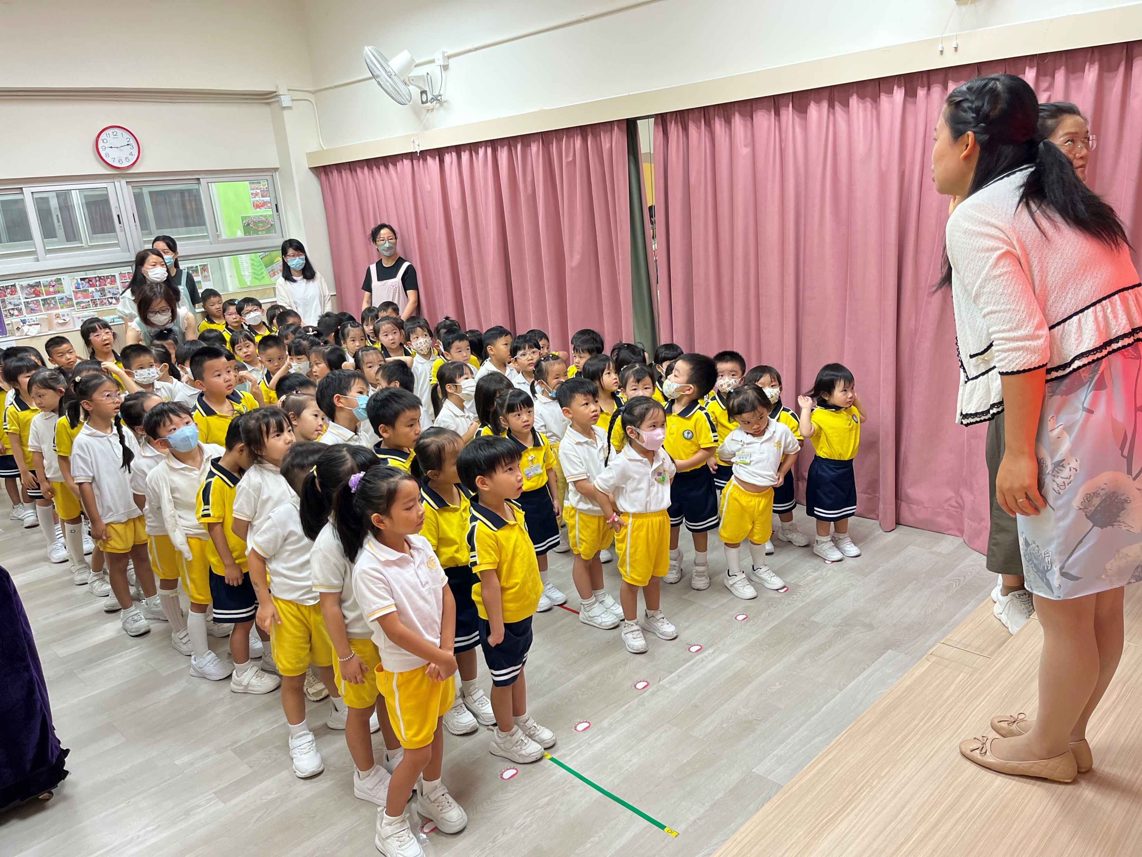
Target audience: All students and staff.
Event Objective: To understand the Chinese national flag, learn to respect the flag through the flag-raising ceremony, and enhance national identity and belonging.
Date: September 2024.
Participate together in the flag-raising ceremony!
Event Introduction: In conjunction with the National Day, we will organize a flag-raising ceremony for all students and staff. During this process, children will personally experience the flag-raising ceremony, fostering their patriotic feelings.

